Slide 1
Integrating Pharmacotherapy and Behavioral Therapy in Treating Patients with Substance Use Disorders Roger D. Weiss, M.D. McLean Hospital Harvard Medical School rweiss@mclean.harvard.edu

Slide 2
Disclosures
Dr. Weiss has previously consulted to Alkermes, which manufactures extended-release naltrexone (Vivitrol)

Slide 3
What are the Goals of Behavioral Therapy in Addition to Medication Treatment?
Medication adherence
Define and attain SUD goals: abstinence or reduction
Deal with other problems: mental and physical health, interpersonal, work/school, housing, etc.

Slide 4
Job 1: The Importance of Medication Adherence
Medications only work if you take them.
Many people don’t take them.

Slide 5
Common Reasons for Patient Non-Adherence to Medications
Medication-related
Perceived or real ineffectiveness
Intolerable side effects
Cost
Overly complex regimen

Slide 6
Adherence Rates by Dosing Frequency (Claxton, 2001)
1x/d 78%
2x/d 68%
3x/d 65%
4x/d 50%

Slide 7
Common Reasons for Patient Non-Adherence (2)
Patient-related
Denial of disorder
Poor/no plan for treatment adherence
Lack of understanding of the need for consistent dosing
Misconceptions or fears about the medications
Forgetfulness (perhaps in part due to the disorder or the medication)

Slide 8
Common Reasons for Patient Non-Adherence (3)
SUD-related
Desire to get high with the medication, e.g., taking too much
Medication interferes with or blocks drug high
Patient does not want to mix alcohol/drugs with medications
Social support-related
Family/friends/peer support group members discourage use of medication
Perceived stigma attached to taking the medication

Slide 9
Common Reasons for Patient Non-Adherence (4)
Medical professional-related
Clinician unsure about treatment’s effectiveness
Poor communication about rationale, risks/benefits, and how to use the medication
Psychiatric-related
Severe depression/pessimism about treatment
Anxiety about side effects
Impatience waiting for medication to work (taking too much)

Slide 10
Strategies to Increase Medication Adherence
The approach to the patient
External reinforcement, e.g., family
Prescribing patterns

Slide 11
Strategies to Increase Medication Adherence: the Approach to the Patient
Actively discuss adherence issues
Are you taking your meds? How much are you taking?
Illness education (why patient needs medication)
Ask about obstacles to adherence (e.g., comprehension, emotions, complexity, cost)
Behavioral aids (Post-its, alarm on phone/watch)

Slide 12
Strategies to Increase Medication Adherence: External Reinforcements
Family education
Family support, e.g., disulfiram contract
Contingency management, e.g., rewards for taking medication

Slide 13
Strategies to Increase Medication Adherence: Prescribing/Dosing Issues
Simple regimens
Pill boxes
Longer-acting or “forgiving” medications
Depot medications (e.g., injectable buprenorphine or naltrexone)

Slide 14
Pharmacotherapy of Alcohol Use Disorder

Slide 15
FDA-Approved Medications for Alcohol Use Disorder
Disulfiram
Naltrexone
Acamprosate

Slide 16
Disulfiram
Inhibits aldehyde dehydrogenase, an enzyme in the metabolism of alcohol
Acetaldehyde poisoning when alcohol ingested
Reaction occurs 10-15 min. after drinking
Non-adherence very common
Only suitable for patients seeking abstinence

Slide 17
Disulfiram Contract
Incorporated as part of behavioral couples therapy
Spousal monitoring
Mutual thanking
“Thanks for taking your disulfiram.”
“Thanks for reminding me and watching me.”
No discussion of past or future drinking outside of meetings with therapist

Slide 18
Disulfiram Contract Outcomes
Reduced drinking
Greater marital satisfaction
Less intimate partner violence
Better functioning in children

Slide 19
Naltrexone for Alcohol Use Disorder
Mechanism of action: May reduce alcohol-induced craving (priming response) and alcohol reward
Does not reduce likelihood of any drinking, but reduces likelihood of heavy drinking; helps contain a slip (lapse) rather than leading to relapse
Comes in oral and extended-release (4-week) IM injectable form
Like with disulfiram, non-adherence is very common, with resultant poor outcomes

Slide 20
Potential Value of Cognitive-Behavioral Therapy (CBT) with Naltrexone for Alcohol Use Disorder
CBT includes discussion of abstinence violation effect
Distinguishing between lapse (slip) and full-blown relapse
Similar to mechanism of action of naltrexone

Slide 21
Naltrexone + CBT for Alcohol Use Disorder
Anton et al. (2005)
160 pts on naltrexone or placebo randomized to 12 CBT or 4 motivational enhancement therapy (MET) sessions over 12 weeks
Naltrexone (ntx) patients had longer time to relapse than placebo
Ntx + CBT patients had best outcomes, better than ntx + MET
Some conflicting studies on specific value of CBT with ntx

Slide 22
Acamprosate
Mechanism of action: interacts with glutamate and GABA neurotransmitters systems
May reduce protracted withdrawal symptoms

Slide 23
Acamprosate: Turning a Lemon into Lemonade
Requires 3x a day dosing
The ‘tid’ method

Slide 24
NIAAA COMBINE Study
Studied optimal combinations of medications, behavioral Tx for alcohol use disorder (N=1,383)
Patients receive naltrexone, acamprosate, both, or neither; all pts receiving pills received Medical Mgmt
Half of the patients received specialized psychotherapy (the Combined Behavioral Intervention, or CBI), in addition to Medical Management (MM)
Results: Naltrexone, CBI both effective, but no combinations improved outcomes
One cohort received CBI alone, no pills or MM: enabled an examination of placebo effect (CBI vs. CBI + placebo pills + MM)
Anton et al., 2006

Slide 25
Percent Days Abstinent at Baseline (Past 90 Days) and Week 16
Percent Days Abstinent | Baseline (mean) | Week 16* (mean) | Mixed model p-value
CBI+MM+Placebo (n = 156) | 25 | 80 | 0.0002
MM+Placebo (n = 153) | 25 | 74
CBI Alone (n = 157) | 24 | 67
*Pair-wise comparison tests:
1 vs. 2, p = 0.04
2 vs. 3, p = 0.03
1 vs. 3, p < 0.001
Weiss et al., 2008

Slide 26
‘Active ingredients’ of MM
Overall health check
Advice to abstain from drinking
Check on medication: efficacy, tolerability, adherence
Advice to attend mutual-help groups, e.g., AA

Slide 27
Percentage of Patients Attending AA in the Week Before Baseline and During Treatment
Patients Attending AA | Baseline n % | During Treatment n %
MM+Placebo | 35 23 | 24 32
CBI+MM+Placebo | 34 22 | 51 33
CBI Alone | 35 22 | 32 20
Chi-square = 7.38, df = 2, p < 0.03

Slide 28
Did AA Attendance Account for Better Drinking Outcomes in the 2 Groups Receiving MM + Placebo?
Partially
AA attendance during treatment was a significant predictor of % days abstinent during treatment (p=.03)
But
When the overall analysis was adjusted for AA attendance during treatment, the differences remained significant (p<0.001)

Slide 29
Pill-Taking
A daily reminder of the reason for
the pill-taking
Reinforces recovery efforts
An additional benefit of medication adherence

Slide 30
Pharmacotherapy of Opioid Use Disorder

Slide 31
OUD Medications: Agonist (Methadone), Partial Agonist (Buprenorphine), Antagonist (Naltrexone)
Full Agonist
(Methadone)
Intrinsic Activity
Partial Agonist
(Buprenorphine)
Antagonist (Naltrexone)
Log Dose of Opioid

Slide 32
Buprenorphine and Behavioral Interventions

Slide 33
Drug Abuse Treatment Act of 2000 in U.S.A.
“Physicians must attest that they have the capacity to refer addiction treatment patients for appropriate counseling”

Slide 34
What is “Appropriate Counseling?”

Slide 35
Prescription Opioid Addiction Treatment Study (POATS)
Largest study of treatment of prescription opioid dependence (N=653 at 10 U.S. sites)
Studied different lengths of buprenorphine-naloxone (bup-nx) + different intensities of counseling
‘Success’: abstinence or near-abstinence from opioids
7% success with 4-week taper
49% success while stable on bup-nx x 12 wks
9% success after 2nd taper after 12-wk bup-nx
Adding counseling to bup-nx and weekly medical management did not improve outcome
Weiss et al. 2011

Slide 36
Counseling in the context of buprenorphine treatment
4 major studies have shown that adding counseling to buprenorphine + medical management (MM) is not superior to buprenorphine + MM alone
Carroll & Weiss, 2017

Slide 37
Key questions
Is buprenorphine that effective?
Is MM that effective?
Is counseling that ineffective for this population?
Are there subgroups of patients who benefit from additional counseling, including those with co-occurring psychiatric disorders?

Slide 38
Question #1: Is buprenorphine that effective?
Wei

Slide 39
Is buprenorphine that effective?
Compared to what?
Yes-- but room for improvement

Slide 40
Question #2: Is medical management that effective?
Wei

Slide 41
‘Active ingredients’ of MM
Overall health check
Urine monitoring
Check on medication: efficacy, adherence, tolerability
Monitor craving
Advice to abstain
Advice to attend mutual-help groups
But, MM in these studies more intensive than community standard

Slide 42
Question #3: Are behavioral treatments that ineffective with this population?
Wei

Slide 43
Are all behavioral interventions ineffective with this population?
No

Slide 44
Are behavioral interventions that ineffective?
3 RCTs show benefit of behavioral tx
All had either contingency management, computerized treatment, or both
App-based interventions currently in use, some of them offering contingency management within the app
Bickel et al., 2000
Schottenfeld et al., 2005
Christensen et al., 2014

Slide 45
RCTs vs. Real-world Results
Non-randomized observational and database studies may yield different results from RCTs
Different level of patient motivation
No research infrastructure support

Slide 46
Are behavioral interventions that ineffective?
Samples., 2022
Retrospective study of Medicaid data base, 2013-18 in ~5,000 pts with OUD
74% of pts had no or few (<1 day/month) psychosocial services
17% had low-intensity services (avg. <2 days/month)
9% had high-intensity services (avg. 7 days/month)

Slide 47
Are behavioral interventions that ineffective?
Samples., 2022
Buprenorphine retention was higher in the 2 groups receiving psychosocial services
Median days retained:136 vs.145 vs. 84 for high, low, and no services
> 180 days retained: 42% vs. 43% vs. 32% for high, low, and no services
Some patients do well with bupe and MM and no other psychosocial services

Slide 48
Are behavioral interventions that ineffective?
Samples., 2022
Distinctions between data base studies vs. RCTs
Non-randomized studies: high-intensity tx can reflect poor initial outcomes
MM in RCTs could approximate low or even high-intensity services in database studies

Slide 49
Question #4: Are there subgroups that benefit from behavioral treatments?
Wei

Slide 50
Are there subgroups of patients who benefit from behavioral interventions?
POATS analysis compared outcomes of patients with and without additional counseling among those pts with
More severe drug problems
Co-occurring psychiatric illness

Slide 51
Did drug counseling improve outcomes in patients with more severe problems? (n=266 with adequate adherence (>60%)
Interaction between heroin & treatment p=.03 Weiss et al., 2014

Slide 52
Did drug counseling improve outcomes in POATS patients with co-occurring PTSD?
19% of POATS pts had PTSD
Those with PTSD had more successful outcomes if they received drug counseling (67% successful with MM + counseling vs. 36% successful with MM alone)
No difference between conditions for those without PTSD
Interaction significant (p<0.05)
McHugh et al., 2021

Slide 53
What about mutual-help group involvement?

Slide 54
Correlates of opioid abstinence over time in POATS follow-up study: Current treatment
Agonist treatment had by far the best correlation with opioid abstinence over time, with odds ratios = 3-5
Mutual-help group attendance also correlated with abstinence, with odds ratios = 2-3
Weiss et al., 2019

Slide 55
What about group treatment?

Slide 56
Models of group treatment with buprenorphine (Sokol et al., 2018)
Shared medical visit
Group-based OUD treatment
Both models seem feasible, well-accepted
Lower-cost
No rigorous randomized controlled trials vs. individual therapy or vs. MM alone
Research needed on this model, though group therapy research is daunting methodologically

Slide 57
What about other behavioral treatments?

Slide 58
Frequently used but not well-studied behavioral treatments
Case management
Recovery coaches/peer navigators
Mindfulness
Exercise
Yoga
Acupuncture
Telehealth

Slide 59
How to proceed? Consider a stepped care model

Slide 60
Factors to weigh in considering behavioral treatment with buprenorphine
Many patients do well with buprenorphine and MM alone, but we’re not good at predicting who will and who won’t do well
Limited resources for MM, behavioral tx
Some patients don’t want counseling
Understanding the importance of early treatment response may help our decision-making

Slide 61
Does early response to buprenorphine predict later treatment outcome?

Slide 62
Background and Rationale
Some medications, e.g., antidepressants, may take a number of weeks to work optimally. Therefore, waiting several weeks to examine treatment response may be helpful.
2) What about the typical time course of treatment response to buprenorphine in treatment of OUD?
3) Knowing this could help guide clinical practice early in the treatment of this population.

Slide 63
Methods
Positive predictive value = the degree to which initial opioid abstinence predicted final successful outcome at the end of buprenorphine stabilization (weeks 9-12).
Negative predictive value = the degree to which initial opioid use predicted final unsuccessful outcome at the end of buprenorphine stabilization.

Slide 64
Predicting abstinence at end of tx (weeks 9-12)
 | Initial abstinence and final abstinence, n | Initial abstinence and final lack of abstinence, n | Positive Predictive Value, %
Week 1 | 101 | 107 | 49%
Weeks 1-2 | 88 | 70 | 56
Weeks 1-3 | 73 | 54 | 57
Weeks 1-4 | 68 | 45 | 60

Slide 65
Predicting use in weeks 9-12
 | Initial use and final lack of abstinence, n | Initial use and final abstinence, n | Negative Predictive Value, %
Week 1 | 122 | 30 | 80%
Wks 1-2 | 89 | 6 | 94
Wks 1-3 | 72 | 3 | 96
Wks 1-4 | 58 | 2 | 97

Slide 66
The importance of early tx response (cont.)
Luo et al., 2023
Harmonized data from 3 large studies of OUD treatment
First 3 weeks were critical predictors of relapse
(4 consecutive weeks of use)
Negative urine tests in weeks 1-3: 13% relapsed
Positive or missing urines in weeks 1-3: 85% relapsed

Slide 67
Conclusions: the importance of early tx response
The first 2-3 weeks of treatment with buprenorphine yield important information
2) Patients who abstain from opioids in the first 2-3 weeks have a good-to-excellent chance of good 12-week outcome
3) However, those who use opioids in each of the first 2-3 weeks (even in week 1 alone) are far less likely to have a good 12-week outcome
4) Although not possible in POATS, increasing intensity of psychosocial treatment should be considered
McDermott et al., 2015

Slide 68
Naltrexone and Behavioral Interventions in Opioid Use Disorder

Slide 69
Behavioral treatments with naltrexone treatment of opioid use disorder
Adherence to oral naltrexone in OUD is poor; oral naltrexone ineffective for most OUD patients
This was a major reason for development of XR-naltrexone
Some positive results for behavioral Rx, but limited
Contingency management: rewarding taking medication and/or negative urine tests
Behavioral family therapy/observed Rx-taking
Carroll 2001, Nunes 2006, Sullivan 2018

Slide 70
Conclusion
Many factors influence the interaction between meds and behavioral Rx
Efficacy of medication
Severity of the SUD and associated conditions (e.g., psychiatric illness)
Mechanism of action of medication
Tx goal: abstinence vs. reduction
Who is delivering the behavioral Rx
Intensity and context of treatment

Slide 71
Thank you to NIDA for research support and to my colleagues at McLean Hospital and the NIDA Clinical Trials Network

Slide 72
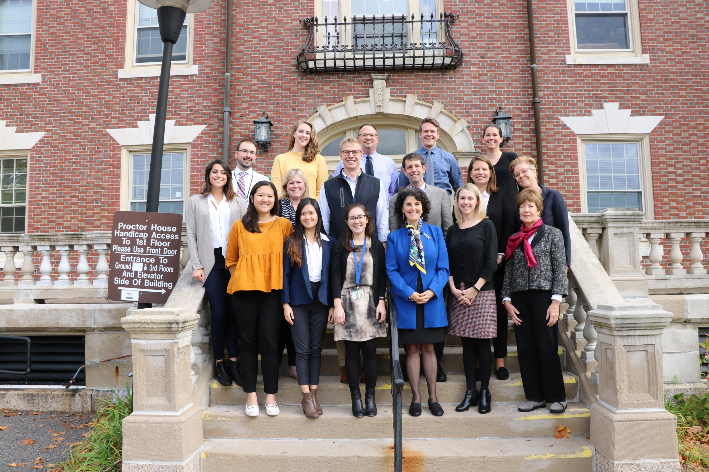
Thank you to NIDA for research support and to my colleagues at McLean Hospital and the NIDA Clinical Trials Network

Slide 73
Questions?

