Slide 1
Mobilizing Schools to Support Student Substance Use and Other Mental Health Concerns
Recovery Science Webinar Series
Randi M. Schuster, PhD
Associate Professor, Harvard Medical School
Founding Director, MGH Center for School Behavioral Health
Director of School-Based Research and Program Development, MGH Center for Addiction Medicine

Slide 2
Working with communities.
The SAMHSA-funded Opioid Response Network (ORN) assists states, organizations and individuals by providing the resources and technical assistance they need locally to address the opioid crisis and stimulant use.
Technical assistance is available to support the evidence-based prevention, treatment, recovery and harm reduction of opioid use disorders and stimulant use disorders.
Funding for this initiative was made possible (in part) by grant no. 1H79TI088037 from SAMHSA. The views expressed in written conference materials or publications and by speakers and moderators do not necessarily reflect the official policies of the Department of Health and Human Services; nor does mention of trade names, commercial practices, or organizations imply endorsement by the U.S. Government.

Slide 3
Working with communities.
The Opioid Response Network (ORN) provides local, experienced consultants in prevention, harm reduction, treatment and recovery to communities and organizations to help address this opioid crisis and stimulant use.
ORN accepts requests for education and training.
Each state/territory has a designated team, led by a regional Technology Transfer Specialist (TTS), who is an expert in implementing evidence-based practices.

Slide 4
Approach: To build on existing efforts, enhance, refine and fill in gaps when needed while avoiding duplication and not
“recreating the wheel.”

Slide 5

Overall Mission
To provide training and technical assistance via local experts to enhance prevention, harm reduction, treatment (especially medications like buprenorphine, naltrexone and methadone) and recovery efforts across the country addressing state and local - specific needs.

Slide 6
Contact the
Opioid Response Network
To ask questions or submit a request for technical assistance:
    Visit www.OpioidResponseNetwork.org
    Email orn@aaap.org

Slide 7


Slide 8
Recovery Science Series Webinars – Past Events
Recovery Support Services: Science and Practice, John Kelly, Ph.D.
Understanding and Addressing Substance Use Disorder Stigma in Clinical Care Settings, John Kelly, Ph.D.
Digital Recovery Support Services, Brandon Bergman, Ph.D.
Using Recovery Science to Dismantle Racial Inequities in Opioid Use Disorder, Corrie Vilsaint, Ph.D.
Examining Opioid Use Disorder Through the Lens of Recovery, Lauren A. Hoffman, Ph.D.
Recovery Community Organizations (RCOs): The Hub of Recovery Support in the Community, Patty McCarthy and Philip Rutherford, Faces & Voices of Recovery
Recovery High Schools as a Protective Factor against the Progression of Substance Use & Co-Occurring Disorders, Andrew Finch, Ph.D.
Collegiate Recovery: From Science to Policy, Noel Vest, Ph.D.
Mutual Help Groups as an Addiction Recovery Resource, Keith Humphreys, Ph.D.
Recovery Homes: Potential and Future Challenges, Leonard Jason, Ph.D.
Building Adolescent and Family Recovery Capital Through Community Supports, Emily Hennessy, Ph.D.
Incorporating Recovery Coaches into General Medical Settings, Dr. Sarah Wakeman and Windia Rodriguez
Considerations for Addressing Substance Use Disorder in Emerging Adults, Ashli Sheidow, Ph.D.
Integrating Behavioral Therapy with Pharmacotherapy in Treating Patients with Substance Use Disorders, Roger Weiss, M.D.
Medications for Stimulant Use Disorder: Evidence, Infrastructure and Cultural Factors that Support Whole Person Care, Steve Shoptaw, Ph.D.
Recovery Coaches: What Do They Do, Where Are They Being Utilized, Are They Effective?, David Eddie, Ph.D.
The “Age of Feeling In-Between”: Contemporary Strategies to Aid Treatment and Recovery for Emerging Adults with Substance Use Disorder, Brandon Bergman, Ph.D.

Slide 9
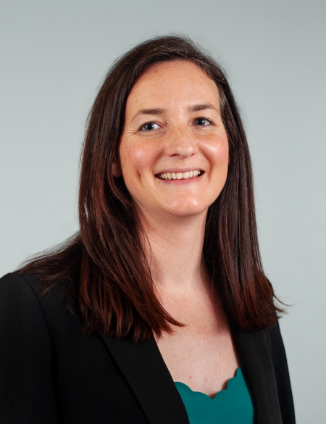
Coming Soon!
Dr. Emily Hennessy of the Recovery Research Institute at Massachusetts General Hospital will present on youth recovery on September 24th, 2025,
at 12:00 PM EST / 9:00 AM PST.
Registration coming soon – will be emailed out to today’s attendees

Slide 10




Polling Questions
A pop-up Zoom window will appear with the poll questions
You must complete all questions before clicking to submit
    Remember to scroll down to see all the questions!
We will share the poll results after a few minutes
Your responses will remain anonymous

Slide 11
Mobilizing Schools to Support Student Substance Use and Other Mental Health Concerns
Recovery Science Webinar Series
Randi M. Schuster, PhD
Associate Professor, Harvard Medical School
Founding Director, MGH Center for School Behavioral Health
Director of School-Based Research and Program Development, MGH Center for Addiction Medicine

Slide 12
Let’s not bury the lead…
Most teens do not use substances. But many do.
While overall rates of (cannabis) use have remained stable, the overall landscape of use has done a 180.
There is a lot we don’t understand. And we need to be honest about that.
There are some things we know for sure…
  Adolescents are at heightened risk for negative effects.
  Adolescents who use (any) substances are more likely to experience other mental health concerns.
  Little wins add up.
Schools represent the prevention arm of our mental health system.

Slide 13
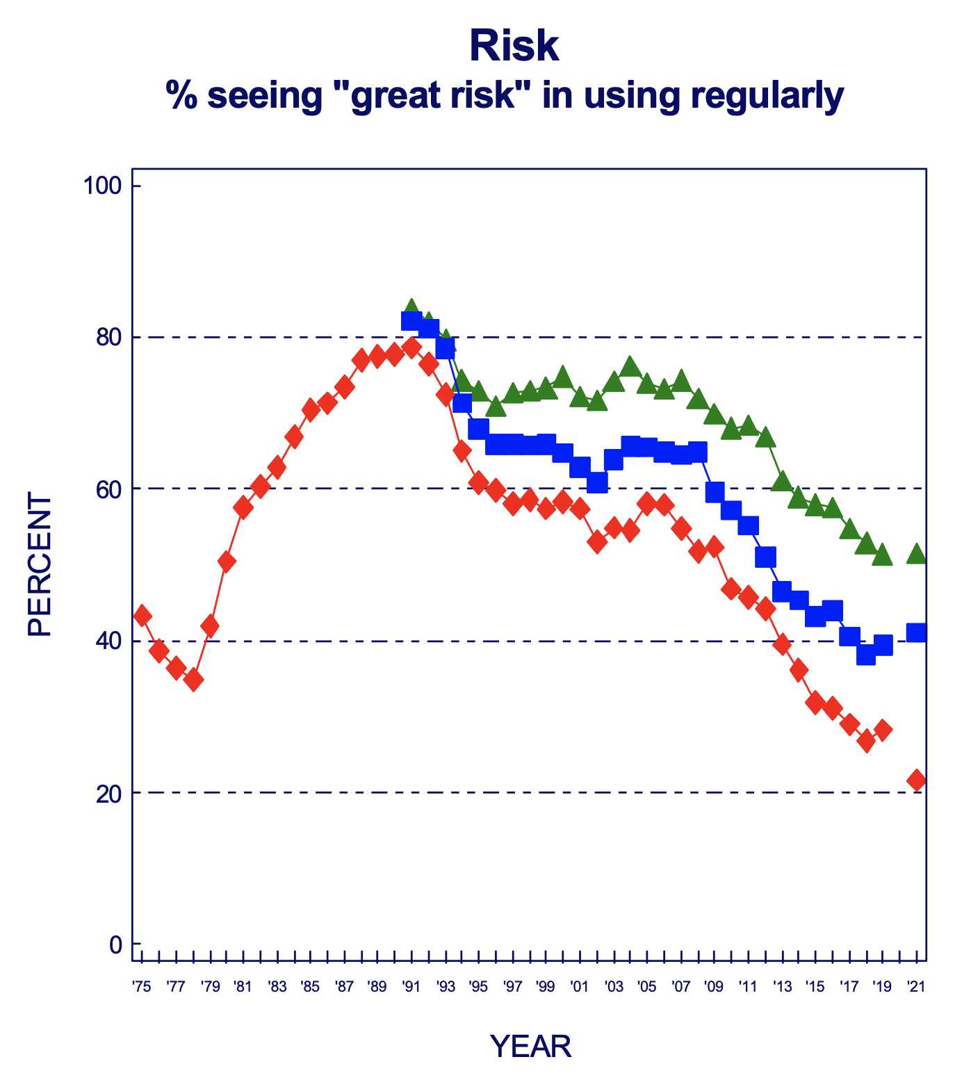
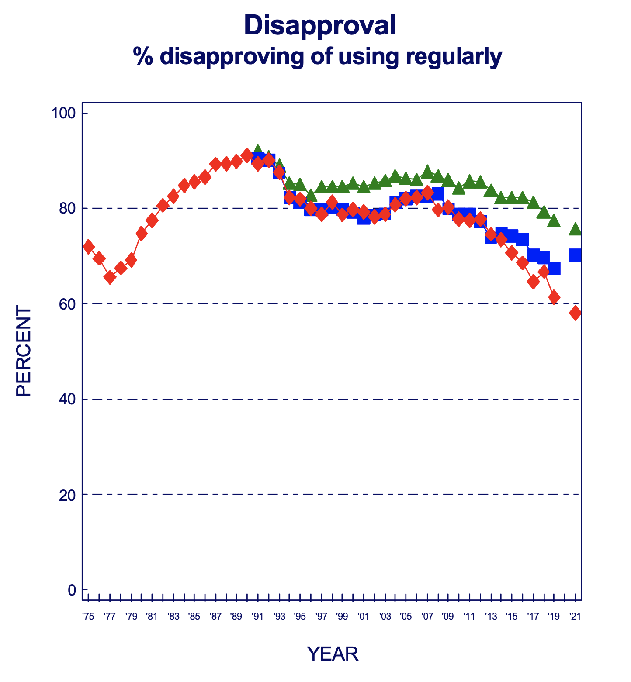
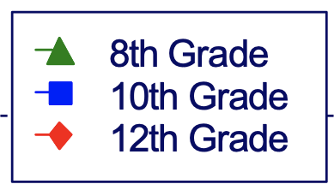
Changes in Perceptions of Harm

Slide 14
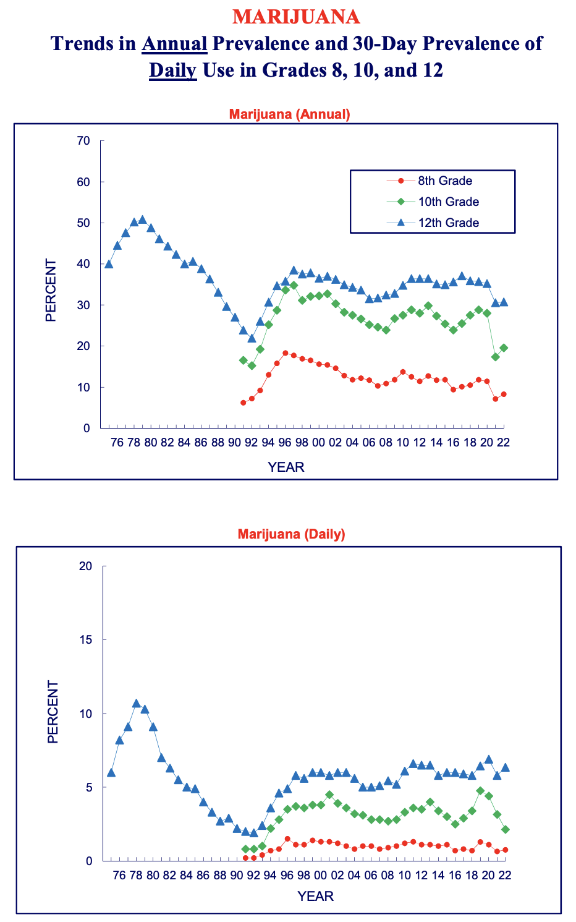
Trends in Annual and Past 30D Prevalence

Slide 15
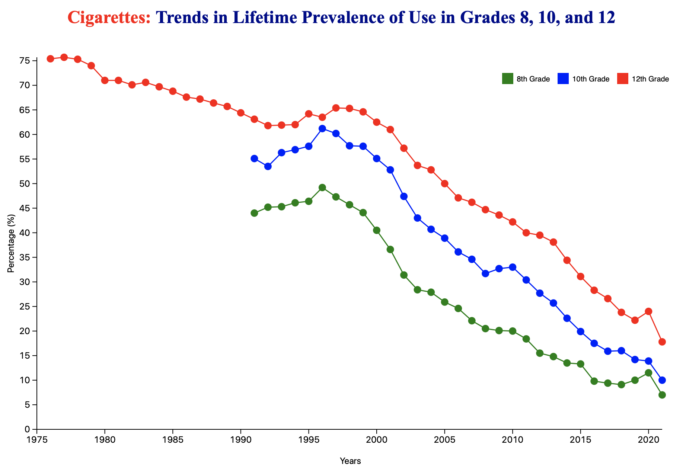
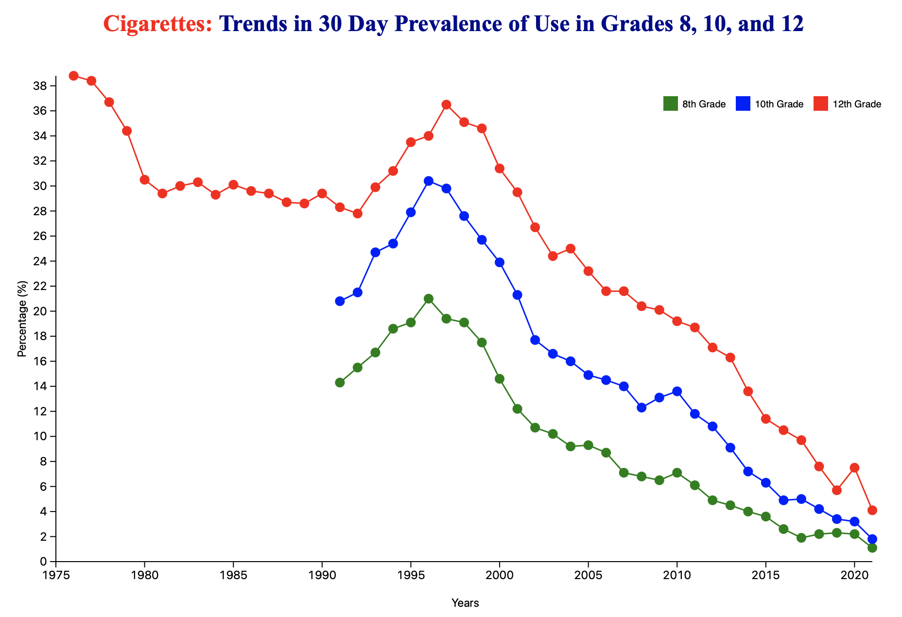
Shifting Landscape of Adolescent Nicotine Use

Slide 16
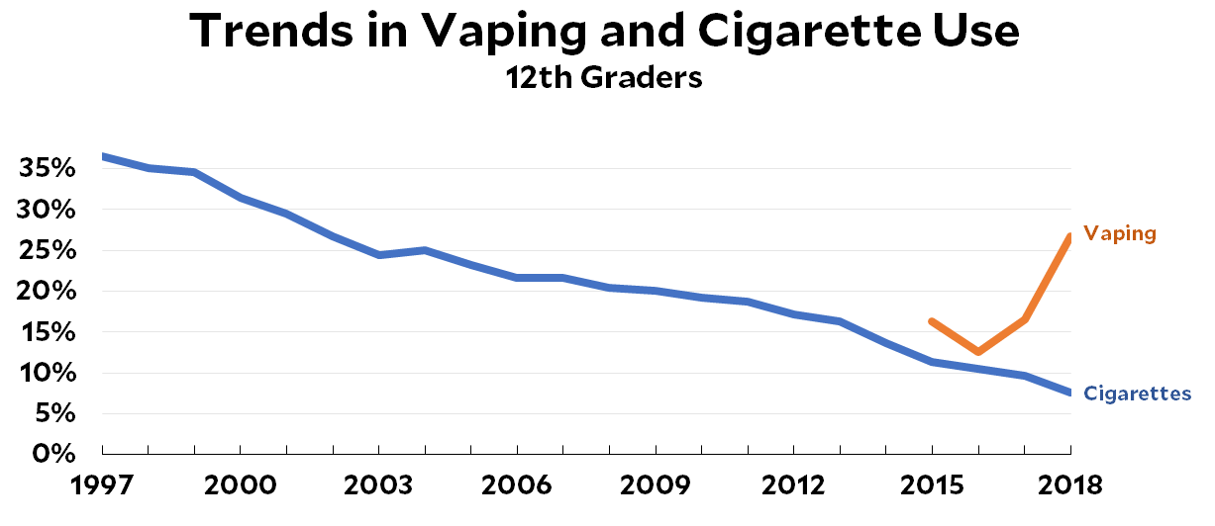
Shifting Landscape of Adolescent Nicotine Use

Slide 17
Disparities in Use
MGH SURF Survey, unpublished

Slide 18
Disparities in Use
MGH SURF Survey, unpublished

Slide 19
Disparities in Use
MGH SURF Survey, unpublished

Slide 20
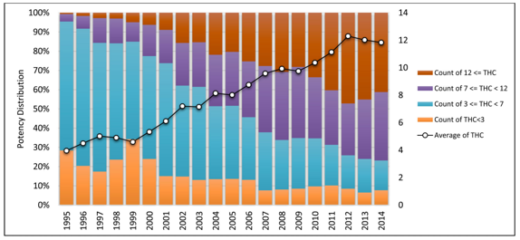
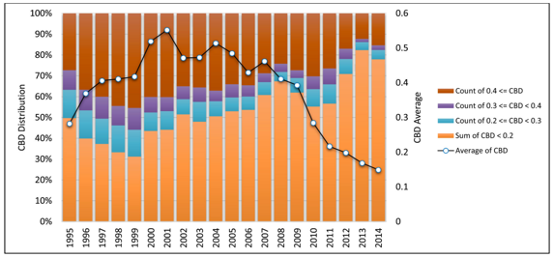
Cannabis is far more potent than in prior decades.
ElSohly et al., 2016, Biological Psychiatry

Slide 22
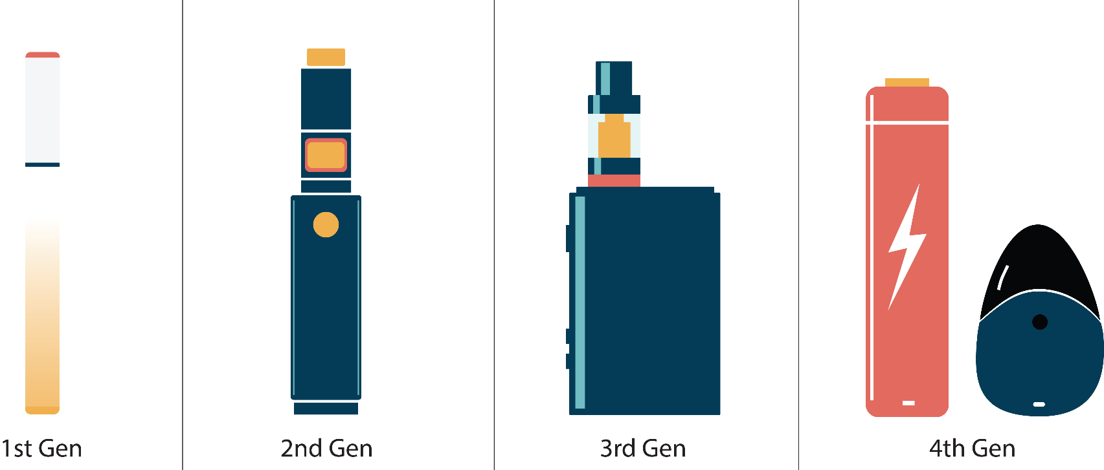
NO MATTER WHAT YOU CALL IT, IT’S AN E-CIGARETTE
Notes:
E-cigarettes are known by many different names. You’ve probably heard them called “vapes,” “vape pens”, “e-cigs” or just “JUUL.” There are also newer products on the market, such as “Elf Bar.” So, no matter what you call it, it’s an e-cigarette.
For more information on different types of e-cigarettes read this guide: E-Cigarette, or Vaping, Products Visual Dictionary (cdc.gov).

Slide 23
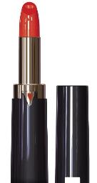
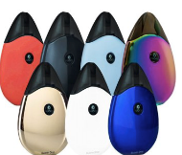
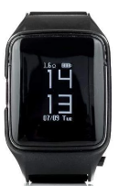
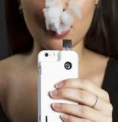
Other vape devices
Notes:
Vapes now come in designs that look like Apple watches (Uwell vape watch), lipstick, hoodies and iPhone cases, making them increasingly difficult to detect.

Slide 25
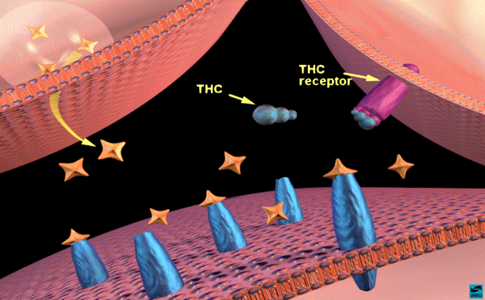
>200 Phytocannabinoids in the Cannabis Plant
Δ9-tetrahydrocannabinol (THC)
  Agonist on endogenous cannabinoid receptors in the central (CB1) and peripheral (CB2) nervous system
  > affinity than endogenous ligand, anandamide
  Euphoric effect comes from THC
  Lipophilic and crosses the BBB and placenta
    Prenatal exposure → hyperactivity, impulsivity and inattention symptoms in childhood
    Elimination half-life of days-weeks
Other cannabinoids (e.g., CBD) that do not cause intoxication
  More commonly discussed when speculating about treatment of neurologic disease (e.g., epilepsy)

Slide 26
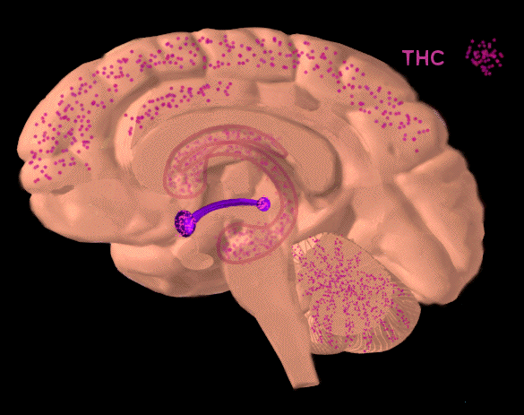
Broad Distribution of THC Binding Sites

Slide 27
Ongoing brain development makes teenage use particularly risky.

Slide 28
Acute Effects of Cannabis Are Well Profiled
Typically peaks 30 minutes after inhalation and 2-4 hours after ingestion
+: Relaxation, euphoria, heightened perception, sociability, sensation of time slowing, increased appetite, decreased pain
-: Paranoia, anxiety, irritability, impaired short-term memory, poor attention and judgment, and poor coordination and balance, tachycardia, hypertension, dry mouth and throat
  Also 2-fold increased odds of respiratory symptoms among those who vape cannabis (Boyd et al., 2021)
↑ with THC content
Tolerance may occur but, effects typically still detectable
Broyd et al., 2106

Slide 29
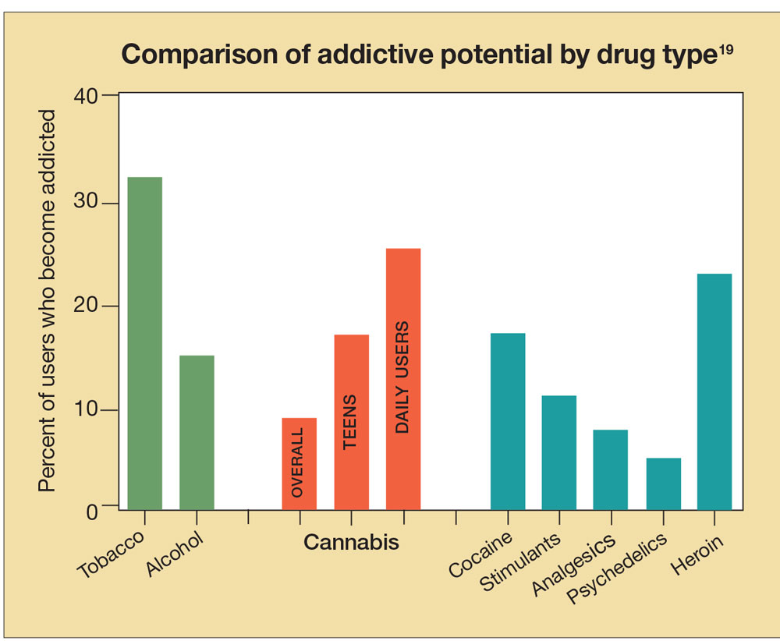
Addiction Liability
Compton et al., 2004; NIDA, 2012a, 2012b; SAMHSA, 2012, 2017

Slide 30
Differences in Encoding Across Five Learning Trials among Controls, Late Onset Marijuana Users and Early Onset Marijuana Users
Learning improved with repetition, with no group effect on the learning slope
Early users learned < words overall than late onset users or CON; Late onset = controls
No differences in percent retention
Early users used < overall learning strategies and < semantic clustering than controls
Schuster, Hoeppner, Evins & Gilman, Neuropsychology 2016

Slide 31
Neurocognitive Recovery with Cannabis Abstinence in High School Students
Continue to use cannabis
Abstain for 30 Days
Baseline
Week 3
Week 4
2-3 days
Week 1
Week 2
4-5 days
Baseline
Week 1
Week 2
Week 3
Week 4
Schuster, et al.,, Journal of Clinical Psychiatry 2018

Slide 32
Greater Vulnerability with Psychiatric Diagnoses?
Radoman et al., 2019

Slide 33
Adolescent Nicotine Use and Cognitive Functioning
Nicotine withdrawal related to deficits in working memory, attention, verbal memory, and inhibitory control
  Most prominent in adolescent users
Cross-sectional studies show adolescent nicotine users have poorer academic performance than non-users

Slide 34
Psychiatric Co-Morbidities

Slide 35


Slide 36


40-50% of kids seeking routine clinical care who used cannabis at least monthly experienced hallucinations or paranoia in the last year
Levy et al., 2019, JAMA Pediatrics

Slide 37
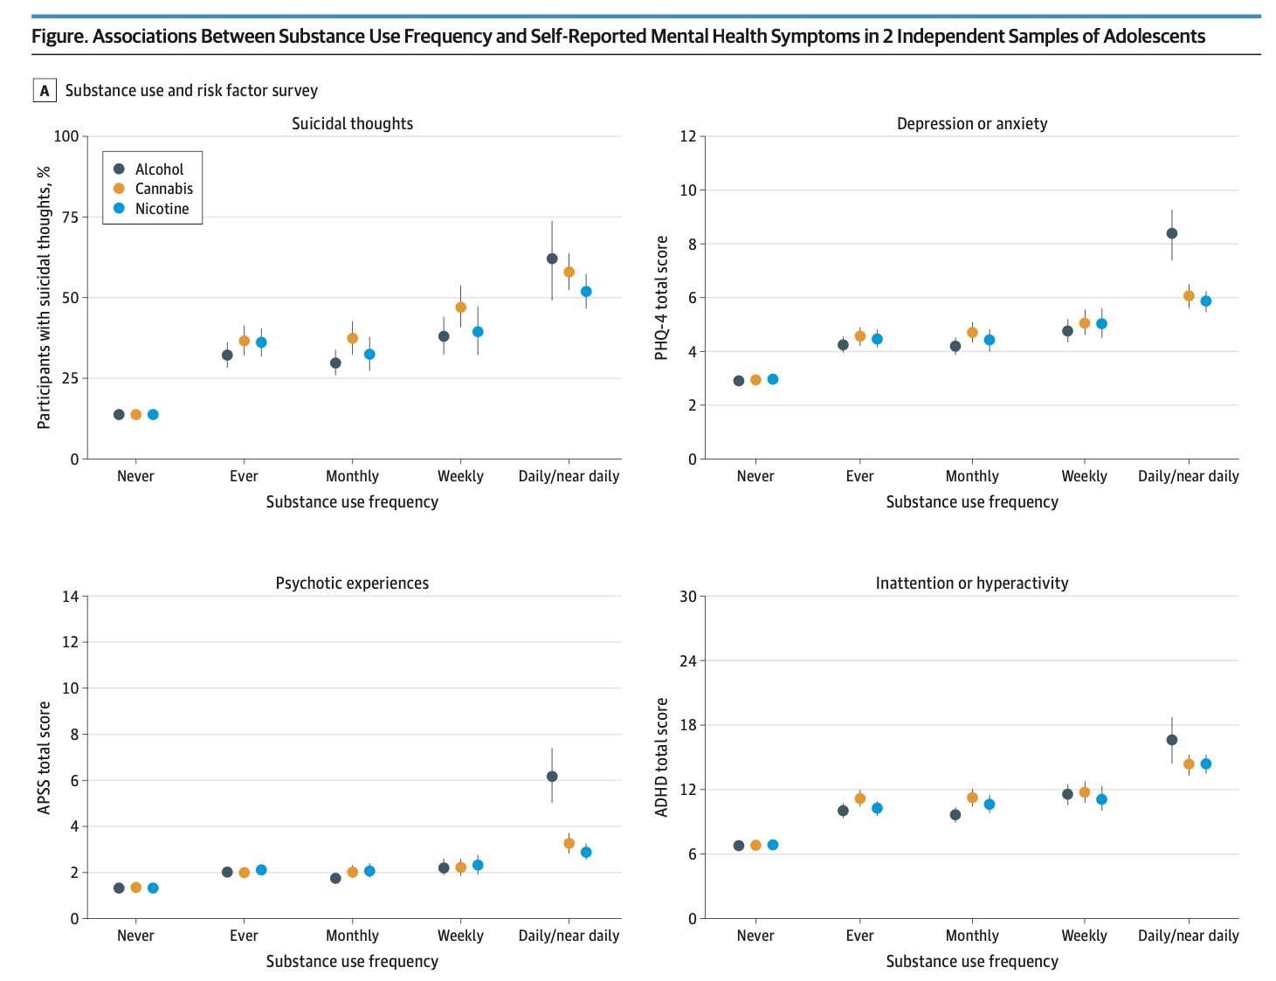
Tervo-Clemmens et al., 2024; JAMA Pediatrics

Slide 38
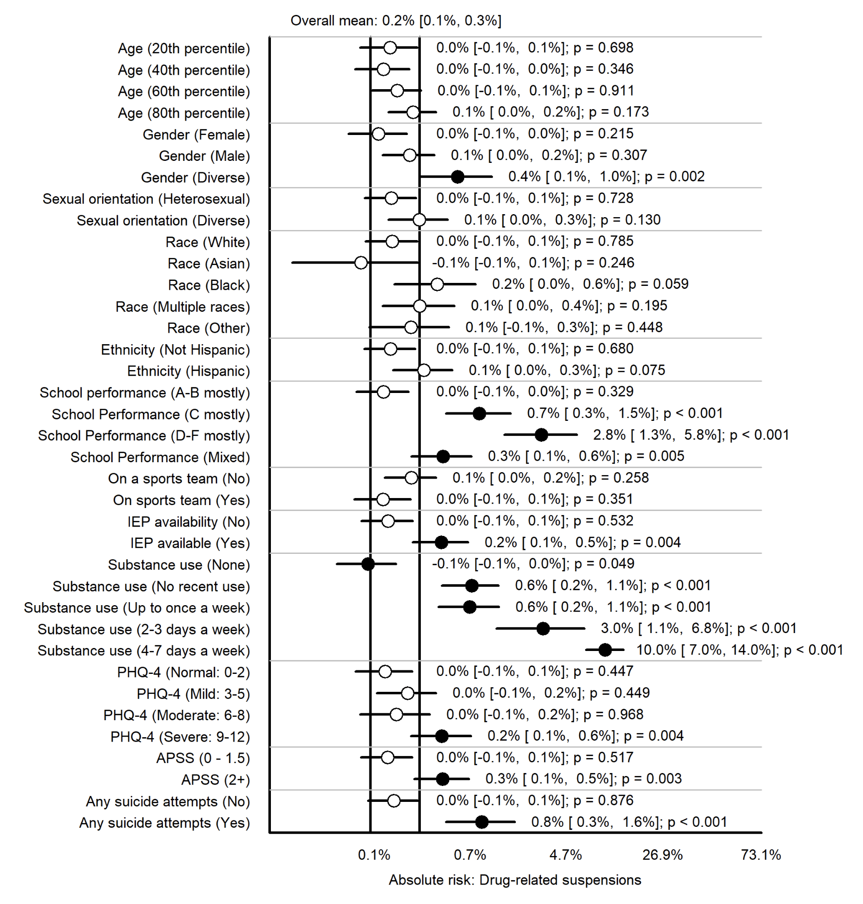
Schuster et al., in preparation

Slide 39
Schools as the Hub for Prevention

Slide 40
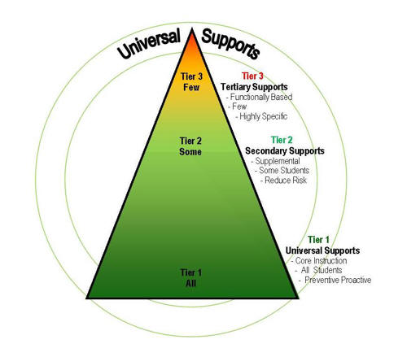
01
Universal prevention
02
Early detection and intervention
Universal screening (SBIRT)
Alternatives to punishment
03
Treatment and Ongoing support

Slide 41
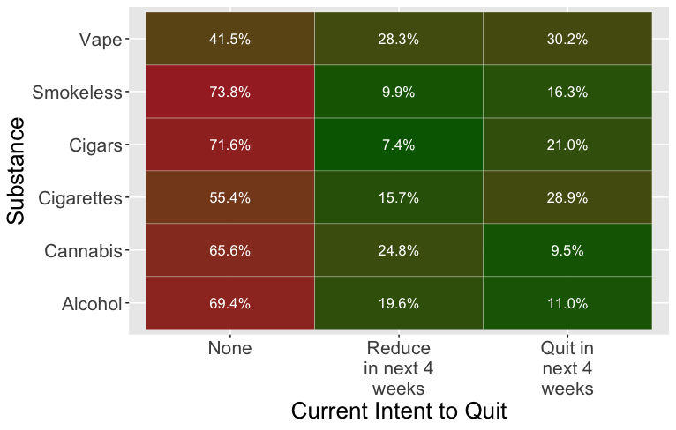
Student Intent to Quit

Slide 42
1 in 5 teens surveyed requested additional support at school.
Most were not currently connected to supports at school..
Costello et al., in press, School Psychology

Slide 43
Mental Health Symptoms Endorsed by Students Who Do and Do Not Self-Refer Following Completion of Anonymous School-Wide Screener
 | Students Self-Referring |  | Students Not Self-Referring |  | Group Comparisons
Depression/Anxiety (PHQ-4) | M=3.7 SD=3.8 |  | M=3.0 SD=3.3 |  | 0.0001
Psychotic-like Symptoms (APSS) | M=1.1 SD=1.6 |  | M=0.9 SD=1.4 |  | 0.0004
Emotional Reactivity (ERS) | M=24.4 SD=23.7 |  | M=20.8 SD=20.8 |  | 0.001
Inattention/Hyperactivity | M=0.8 SD=0.8 |  | M=0.7 SD=0.7 |  | .001
Risk-Taking | M=3.9 SD=1.9 |  | M=3.9 SD=1.8 |  | .57
Lifetime Substance Use (% yes)
Alcohol |  | 20.1% |  | 15.0% | 0.06
Cannabis |  | 10.5% |  | 11.9% | 0.32
Vaped Nicotine |  | 12.3% |  | 12.4% | 0.93
Past-Month Use Frequency (Among participants with lifetime use)
Alcohol | M=0.19 SD=0.74 |  | M=0.19 SD=0.71 |  | .91
Cannabis | M=0.24 SD=1.08 |  | M=0.24 SD=1.02 |  | .89
Vaped Nicotine | M=0.27 SD=1.22 |  | M=0.29 SD=1.11 |  | .65
Suicidal Thoughts and Behaviors
Past-year suicide attempt |  | 6.6% |  | 3.1% | 0.02
Costello et al., in press, School Psychology

Slide 44
Topics Discussed with Referred Students
Domain | Staff Reporting Topic N (%)
Feeling Nervous/Anxious/On-Edge (Symptoms of Anxiety) | 66.7%
Feeling Down/Depressed/Hopeless (Symptoms of Depression) | 60.0%
Stressful Life Events | 53.3%
School-Related Concerns | 53.3%
Problems with Peers | 46.7%
Problems with Family | 40.0%
Problems with Alcohol Use | 33.3%
Problems with Vaping or Other Nicotine Use | 33.3%
Inattention/Restlessness/Hyperactivity (Symptoms of ADHD) | 26.7%
Suicidal Thoughts | 13.3%
Problems with Cannabis Use | 6.7%
Problems with Other Drugs | 6.7%
Other (write-in) | 0.0%
Note: Topics discussed were queried using a “select all that apply” format, and thus, percentages will not sum to 100.
Costello et al., in press, School Psychology

Slide 45
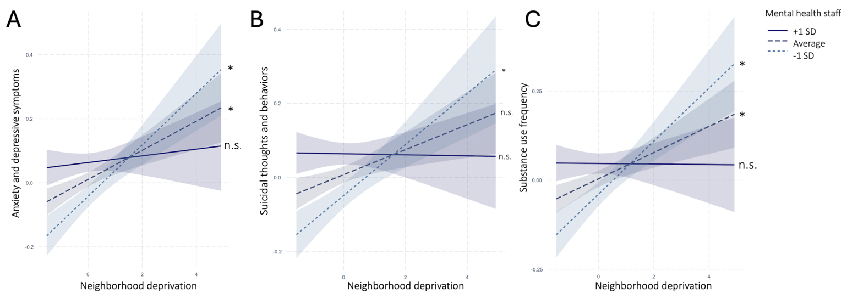
Vargas et al., in press, JAACAP

Slide 46
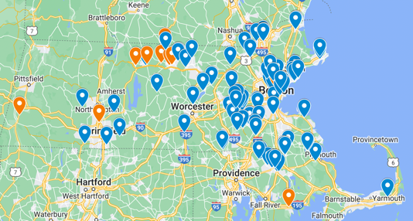

To Contact iDECIDE:
Randi Schuster, PhD (Principal Investigator): rschuster@mgh.Harvard.edu; 617-643-6673
iDECIDE General: iDECIDE@mgh.harvard.edu
Website: www.iDECIDEmyfuture.org
Twitter: @iDECIDEteam
Instagram: @project_iDECIDE
Facebook: https://www.facebook.com/projectiDECIDE
LinkedIn: https://www.linkedin.com/company/projectidecide/

Slide 47




Please reach out with any questions or thoughts…
617-643-6673
Rschuster@mgh.harvard.edu
@RandiMSchuster

