Slide 1
The “Age of Feeling In-Between”: Contemporary Strategies to Aid Treatment and Recovery for Emerging Adults with Substance Use Disorder
Recovery Science Webinar Series
Brandon G. Bergman, PhD
03/26/25

Slide 2
Working with communities.
The SAMHSA-funded Opioid Response Network (ORN) assists states, organizations and individuals by providing the resources and technical assistance they need locally to address the opioid crisis and stimulant use.
Technical assistance is available to support the evidence-based prevention, treatment, recovery and harm reduction of opioid use disorders and stimulant use disorders.
Funding for this initiative was made possible (in part) by grant no. 1H79TI088037 from SAMHSA. The views expressed in written conference materials or publications and by speakers and moderators do not necessarily reflect the official policies of the Department of Health and Human Services; nor does mention of trade names, commercial practices, or organizations imply endorsement by the U.S. Government.

Slide 3
Working with communities.
The Opioid Response Network (ORN) provides local, experienced consultants in prevention, harm reduction, treatment and recovery to communities and organizations to help address this opioid crisis and stimulant use.
ORN accepts requests for education and training.
Each state/territory has a designated team, led by a regional Technology Transfer Specialist (TTS), who is an expert in implementing evidence-based practices.

Slide 4
Approach: To build on existing efforts, enhance, refine and fill in gaps when needed while avoiding duplication and not “recreating the wheel.”

Slide 5
Overall Mission
To provide training and technical assistance via local experts to enhance prevention, harm reduction, treatment (especially medications like buprenorphine, naltrexone and methadone) and recovery efforts across the country addressing state and local - specific needs.

Slide 7
Contact the Opioid Response Network
To ask questions or submit a request for technical assistance:
Visit www.OpioidResponseNetwork.org
Email orn@aaap.org

Slide 8
Recovery Science Series Webinars – Past Events
Recovery Support Services: Science and Practice, John Kelly, Ph.D.
Understanding and Addressing Substance Use Disorder Stigma in Clinical Care Settings, John Kelly, Ph.D.
Digital Recovery Support Services, Brandon Bergman, Ph.D.
Using Recovery Science to Dismantle Racial Inequities in Opioid Use Disorder, Corrie Vilsaint, Ph.D.
Examining Opioid Use Disorder Through the Lens of Recovery, Lauren A. Hoffman, Ph.D.
Recovery Community Organizations (RCOs): The Hub of Recovery Support in the Community, Patty McCarthy and Philip Rutherford, Faces & Voices of Recovery
Recovery High Schools as a Protective Factor against the Progression of Substance Use & Co-Occurring Disorders, Andrew Finch, Ph.D.
Collegiate Recovery: From Science to Policy, Noel Vest, Ph.D.
Mutual Help Groups as an Addiction Recovery Resource, Keith Humphreys, Ph.D.
Recovery Homes: Potential and Future Challenges, Leonard Jason, Ph.D.
Building Adolescent and Family Recovery Capital Through Community Supports, Emily Hennessy, Ph.D.
Incorporating Recovery Coaches into General Medical Settings, Dr. Sarah Wakeman and Windia Rodriguez
Considerations for Addressing Substance Use Disorder in Emerging Adults, Ashli Sheidow, Ph.D.
Integrating Behavioral Therapy with Pharmacotherapy in Treating Patients with Substance Use Disorders, Roger Weiss, M.D.
Medications for Stimulant Use Disorder: Evidence, Infrastructure and Cultural Factors that Support Whole Person Care, Steve Shoptaw, Ph.D.
Recovery Coaches: What Do They Do, Where Are They Being Utilized, Are They Effective?, David Eddie, Ph.D.

Slide 9
Polling Questions
A pop-up Zoom window will appear with the poll questions
You must complete all questions before clicking to submit
Remember to scroll down to see all the questions!
We will share the poll results after a few minutes
Your responses will remain anonymous

Slide 10
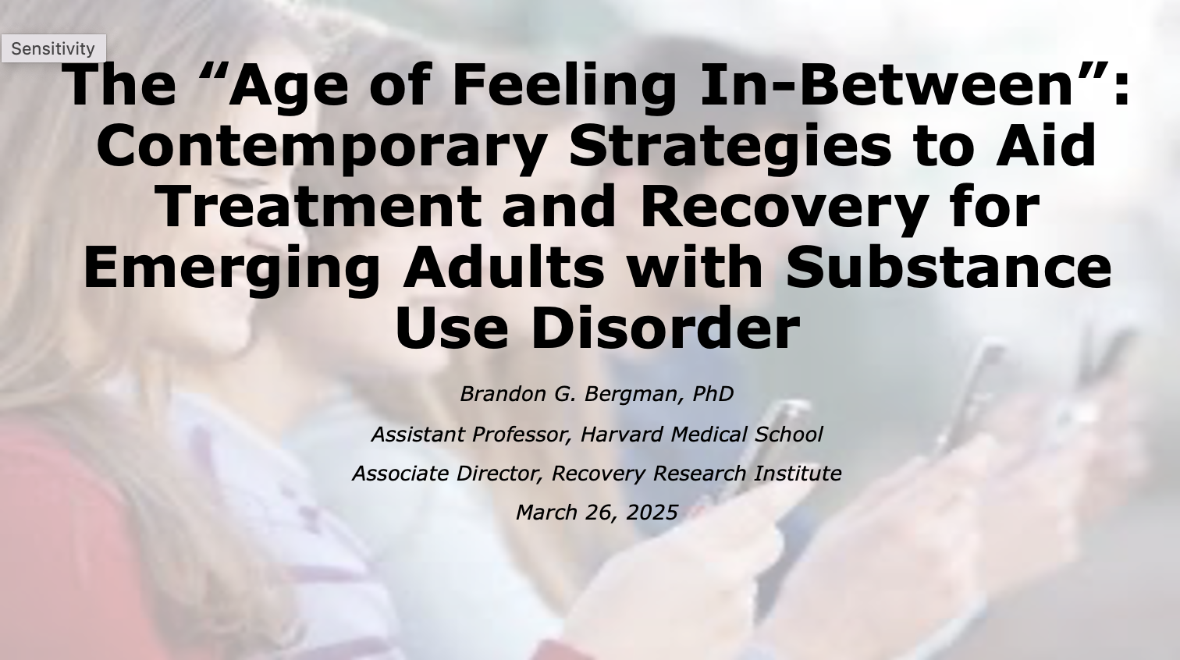

Slide 11
Disclosures
Dr. Bergman’s work is or has been funded by the following organizations and entities
NIAAA
Massachusetts Department of Public Health
Recovery Research Institute
Dr. Bergman has served as a consultant or co-investigator on grants that are submitting and pending, or funded by, the following organizations and entities
NIAAA
NIDA
Dr. Bergman has no direct financial stake in any of these organizations or entities

Slide 12
Objectives/Agenda
1) To operationalize emerging adulthood as a unique stage of the life course
2) To describe differences in substance use disorder (SUD) prevalence and treatment seeking among emerging adults vs. adolescents and established adults
3) To outline challenges in emerging adult SUD treatment and recovery
4) To propose strategies that can address challenges in emerging adult SUD treatment and recovery

Slide 13
Objectives/Agenda
1) To operationalize emerging adulthood as a unique stage of the life course
2) To describe differences in substance use disorder (SUD) prevalence and treatment seeking among emerging adults vs. adolescents and established adults
3) To outline challenges in emerging adult SUD treatment and recovery
4) To propose strategies that can address challenges in emerging adult SUD treatment and recovery

Slide 14
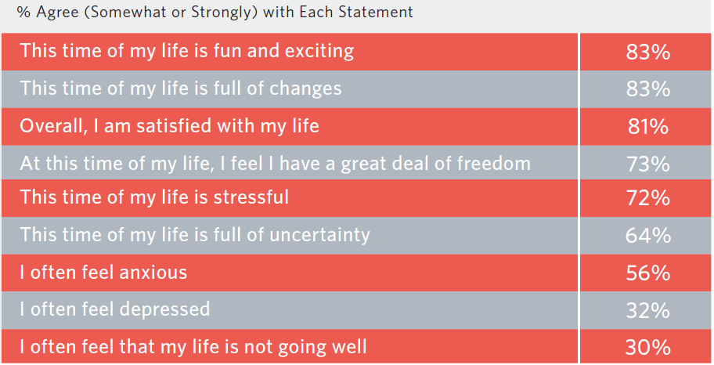
The Extension of “Youth”
Extended timing of establishing stable work, marriage, and parenthood (Arnett et al. 2014)
Emerging adulthood (e.g., 18-29)
Identity explorations
Instability
Self-focus
Feeling “in-between”
Possibilities and
optimism
(Arnett & Schwab, 2012)

Slide 15
Objectives/Agenda
1) To operationalize emerging adulthood as a unique stage of the life course
2) To describe differences in substance use disorder (SUD) prevalence and treatment seeking among emerging adults vs. adolescents and established adults
3) To outline challenges in emerging adult SUD treatment and recovery
4) To propose strategies that can address challenges in emerging adult SUD treatment and recovery

Slide 16
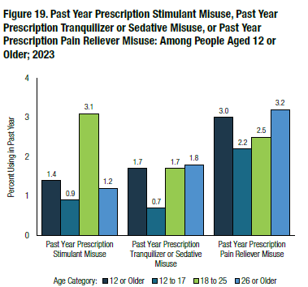
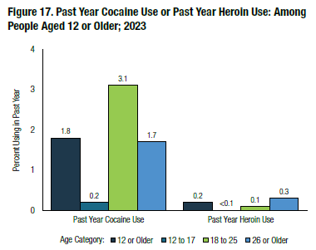
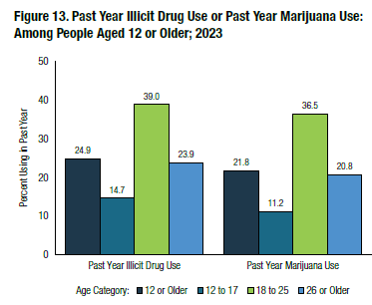
Emerging Adults Disproportionately Evidence Harmful Substance Use
SAMHSA National Survey on Drug Use and Health (NSDUH)

Slide 17
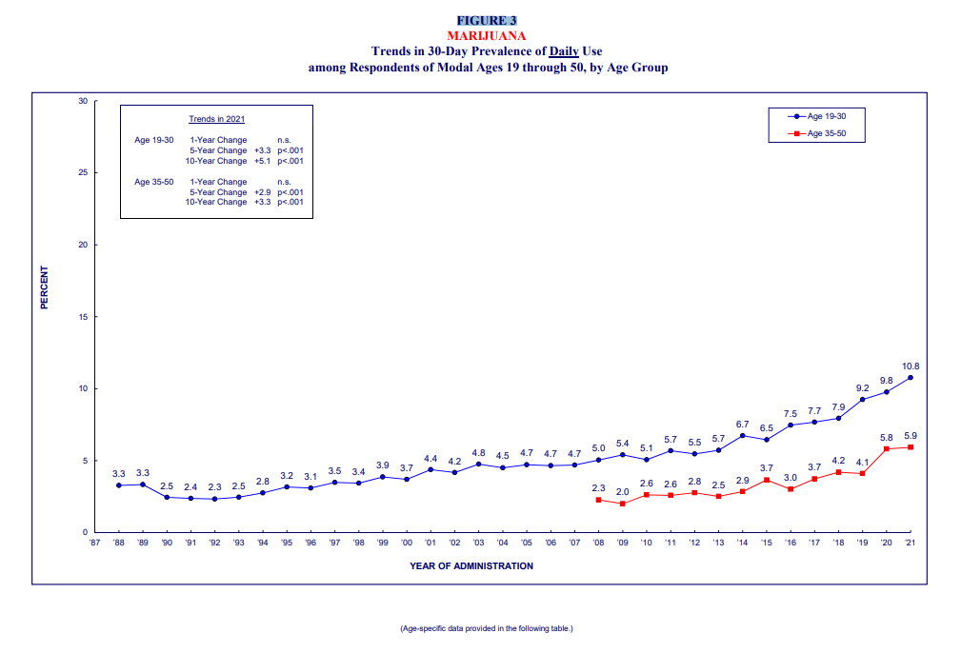
Emerging Adults Disproportionately Evidence Harmful Substance Use
Monitoring the Future Panel Study (Patrick et al. 2022)

Slide 18
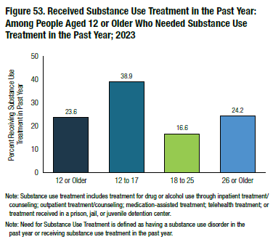
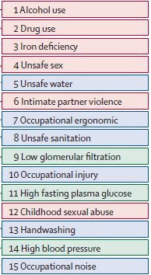
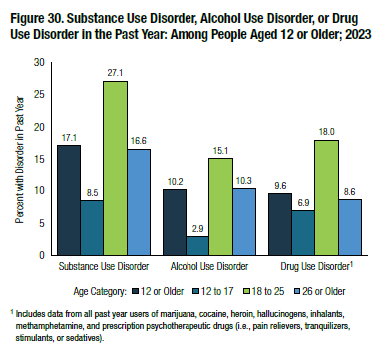
Emerging Adults Disproportionately Evidence Harmful Substance Use
DALY Risk Factors Worldwide
Ages 20-24
SAMHSA NSDUH
Mokdad et al. 2016
SAMHSA NSDUH

Slide 19
Entering Recovery as an Emerging Adult is Associated with Better Functioning
National Recovery Study: Representative sample of US adults who resolved an alcohol or other drug problem
Young adult 18-30 vs. Middle/Older adult 31+
Young adult recovery initiation 1.4 times greater likelihood of current employment (adjusted for age)
Young adult recovery initiation greater current quality of life (adjusted for age, time since problem resolution, treatment history, etc.)
Even larger effects among those with 5 years or less
(Kelly, Greene, & Bergman, 2021)

Slide 20
Questions?

Slide 21
Objectives/Agenda
1) To operationalize emerging adulthood as a unique stage of the life course
2) To describe differences in substance use disorder (SUD) prevalence and treatment seeking among emerging adults vs. adolescents and established adults
3) To outline challenges in emerging adult SUD treatment and recovery
4) To propose strategies that can address challenges in emerging adult SUD treatment and recovery

Slide 22
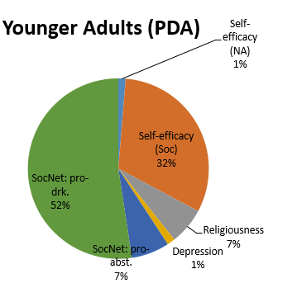
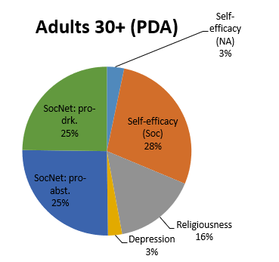
Adolescents vs. Emerging Adults vs. Adults 30+
Emerging adults are harder to engage in treatment – may have worse outcomes than adolescents and older adults (Bergman et al. 2016)
They may benefit from SUD services in different ways
(Hoeppner, Hoeppner, & Kelly, 2014)

Slide 23
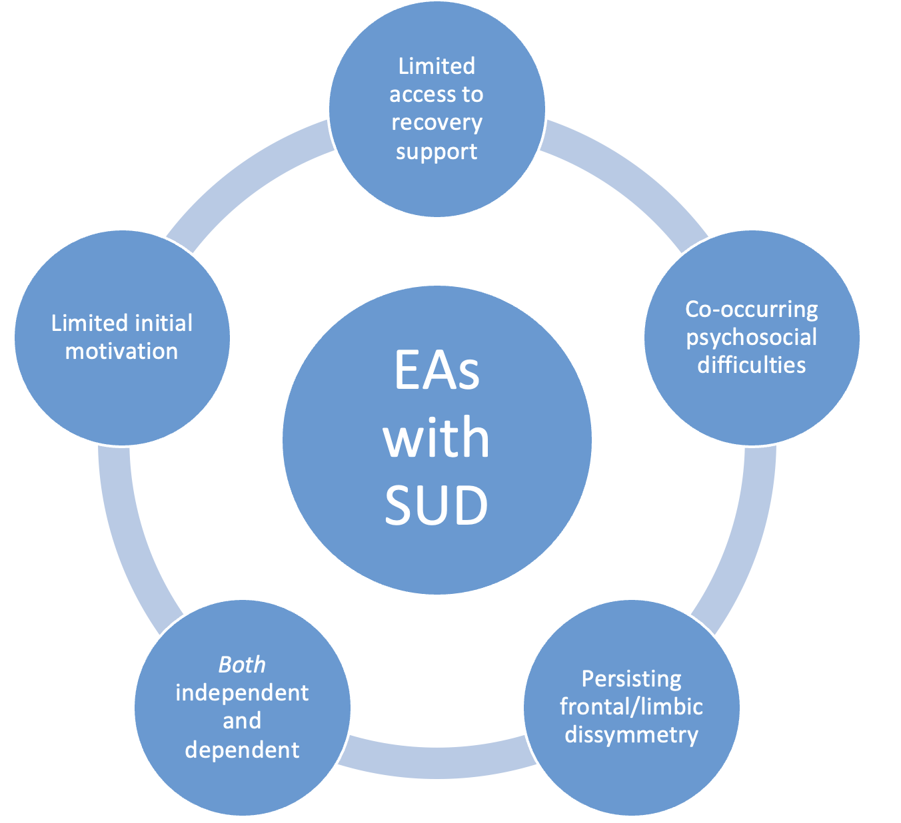
Emerging Adults are Clinically Challenging

Slide 24
Emerging Adults are Clinically Challenging
Emerging Adult with SUD
Consistent treatment attendance and healthy choices
The realities of young adulthood

Slide 25
Questions?

Slide 26
Objectives/Agenda
1) To operationalize emerging adulthood as a unique stage of the life course
2) To describe differences in substance use disorder (SUD) prevalence and treatment seeking among emerging adults vs. adolescents and established adults
3) To outline challenges in emerging adult SUD treatment and recovery
4) To propose strategies that can address challenges in emerging adult SUD treatment and recovery

Slide 27
Strategies
Developmental Framework
Patient-Centered Approach
Developmentally-Tailored Communication
Parent Involvement & Contingency Management
Social Network Interventions

Slide 28
Developmental Framework
Intimacy vs. Isolation (Established Adulthood)
AND
Identity vs. Role Confusion (Late Adolescence)
AND
Industry vs. Inferiority (Early Adolescence)
Think of single treatment episode as part of longitudinal, dynamic recovery process

Slide 29
Patient-Centered Approach
Engagement vs. Adherence
Accommodating both harm reduction and abstinence goals

Slide 30
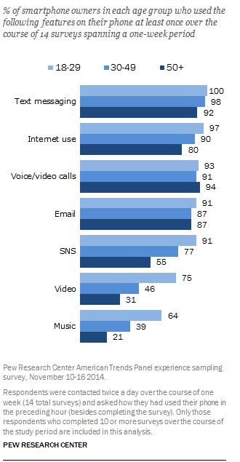
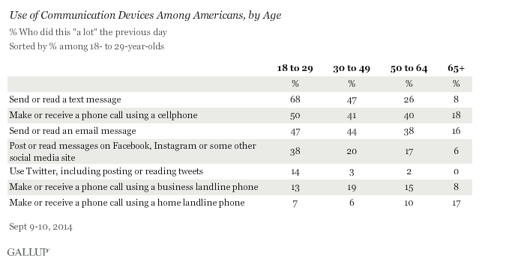
Communication
Mean/Median Texts per Day by Age (Pew, 2011)

Slide 31
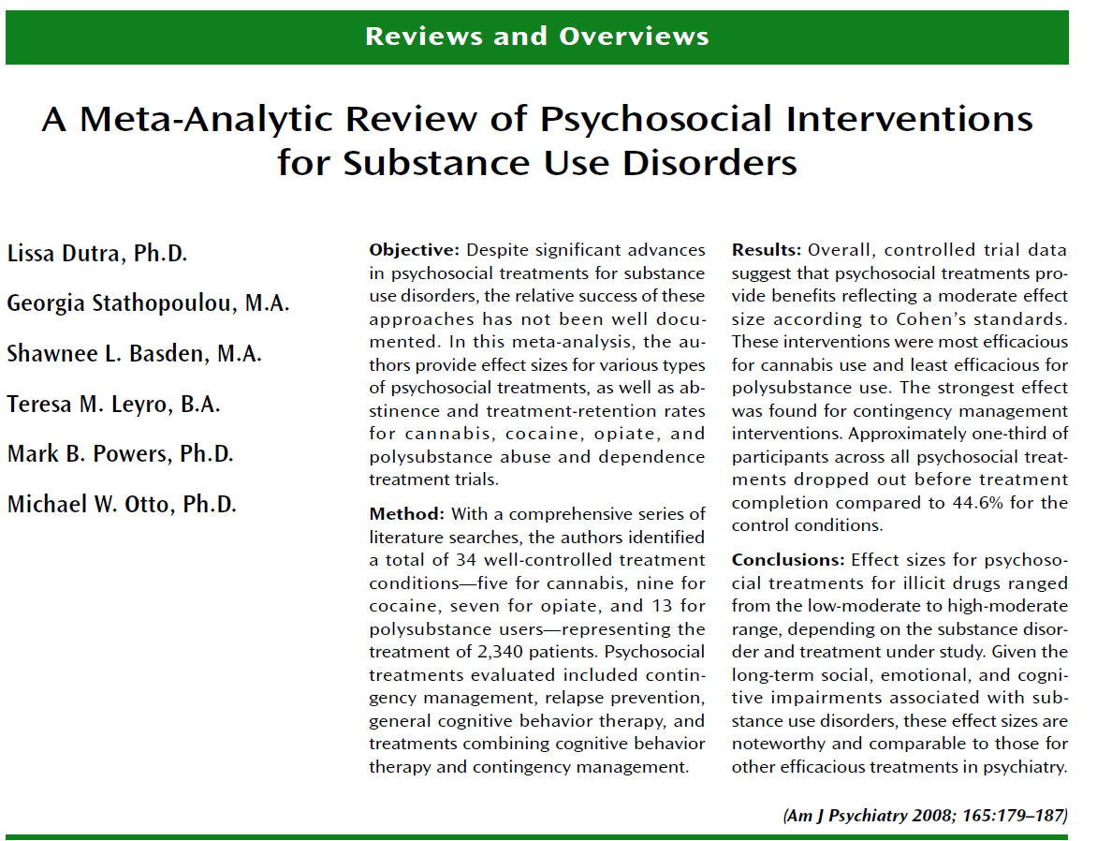
Parent Involvement & Contingency Management
https://www.recoveryanswers.org/research-post/involve-family-in-treatment-enhance-substance-use-disorder-outcomes/
(Arris & Fairbairn, 2020)

Slide 32
Contingency Management: In Brief
Behavior: Measurable, Achievable, Desirable (The “Ables”)
Treatment engagement and substance use
Reward/Consequence: Swift, Certain, Meaningful
Types of Rewards: Car, Cash (or Cash Equivalents), Computer, Cell Phone (The “C”s)
Meaningful = Meaningful to the young adult

Slide 33
Social Network Interventions
Interventions
Adolescent Community Reinforcement Approach
Integrated 12-step Facilitation
Network Support
Young-adult specific community resources
Young adult AA/NA
New-wave mutual-help (e.g., Dharma/Refuge)
Collegiate recovery programs
Recovery community organizations for young adults

Slide 34
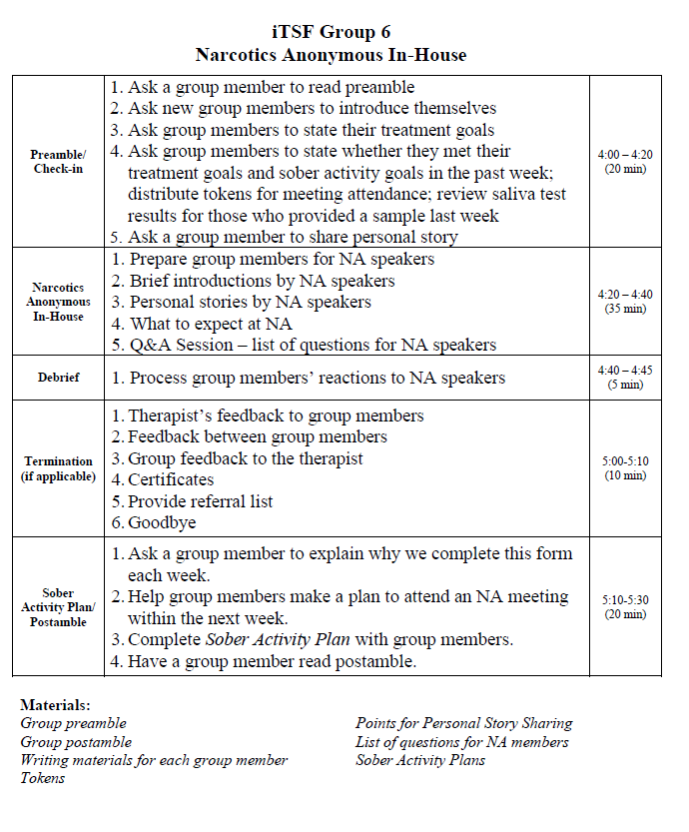
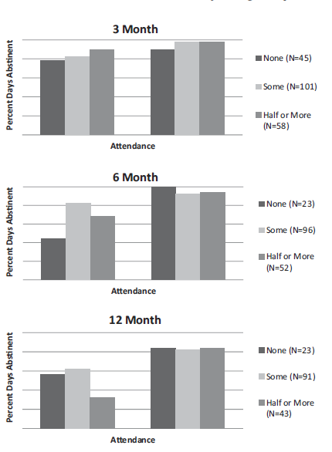
The Power of Social Contagion
(Labbe et al. 2013)
(Kelly et al. 2016)

Slide 35
Ways to Leverage Technology in SUD Treatment/Recovery

Slide 36
Building on Social Norms/Identity and Mutual-Help Research
Socially-derived MOBCs may be mobilized online too
Recovery role models (sponsors; Tonigan & Rice, 2010; Zemore et al. 2013; Kelly et al. 2016)
Social network changes (Kelly et al. 2012; Stout et al. 2012)
Enhanced (AA) friendship quality (Humphreys & Noke, 1996)
AA-specific social support (Kaskutas et al. 2002)
College student exposure to pro-alcohol content on SNSs predicts subsequent drinking increases (Labrie, Boyle)
Social identity theories of health behavior change

Slide 37
Potential Drawbacks
Attendance vs. Active Involvement
Peer-to-Peer Social Connection on Digital Services
Reduced group alliance in tele- vs. in-person therapy
Non-verbal cues in communication
Increased immediacy → “Zoom fatigue”?
More effort and resources needed for rapport building?
Privacy
Digital Divide

Slide 38
Summary
Emerging adults are disproportionately represented in SUD treatment and recovery support settings
They benefit from earlier intervention but can pose unique challenges
Innovative, developmentally sensitive strategies can help address these challenges
Attending to social network changes – in ways consistent with their digitally-immersed day-to-day lives – may be especially helpful

Slide 39
Questions and Comments
e.g., What challenges have you experienced working with emerging adults?
e.g., What strategies do you use to address these challenges?
e.g., What do you find rewarding about working with emerging adults?

Slide 40
Contact
Brandon Bergman
bgbergman@mgh.harvard.edu

